Slide 1
Information Security Fall 2022
Week # 5
Lecture # 13, 14 and 15
Dr. Aqsa Aslam

Slide 2
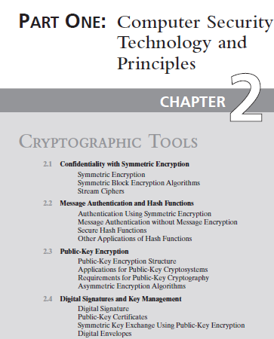
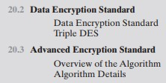

Topics from text book:
Chapter # 2
Chapter # 20
Chapter # 21

Slide 3
Public-Key Encryption
Public-key algorithms are based on mathematical functions
Rather than on simple operations on bit patterns, such as are used in symmetric encryption algorithms.
Public-key cryptography is asymmetric, involving the use of two separate keys
in contrast to symmetric encryption, which uses only one key
The use of two keys has profound consequences in the areas of:
Confidentiality
Key distribution
Authentication

Slide 4
Public-Key Encryption Structure
Misconceptions concerning public-key encryption.
Public-key encryption is more secure from cryptanalysis than symmetric encryption. In fact, the security of any encryption scheme depends on
The length of the key
The computational work involved in breaking a cipher.
There is nothing in principle about either symmetric or public-key encryption that makes one superior to another from the point of view of resisting cryptanalysis.
A second misconception is that public-key encryption is a general-purpose technique that has made symmetric encryption obsolete. On the contrary, because of the computational overhead of current public-key encryption schemes, there seems no foreseeable likelihood that symmetric encryption will be abandoned.
Finally, there is a feeling that key distribution is trivial when using public-key encryption, compared to the rather cumbersome handshaking involved with key distribution centers for symmetric encryption.
For public-key key distribution, some form of protocol is needed, often involving a central agent, and the procedures involved are no simpler or any more efficient than those required for symmetric encryption

Slide 5
Public-Key Encryption Structure
A public-key encryption scheme has six ingredients
Plaintext: This is the readable message or data that is fed into the algorithm as input.
Encryption Algorithm: The encryption algorithm performs various transformations on the plaintext.
Public and private key: This is a pair of keys that have been selected so if one is used for encryption, the other is used for decryption.
The exact transformations performed by the encryption algorithm depend on the public or private key that is provided as input.
Ciphertext: This is the scrambled message produced as output. It depends on the plaintext and the key.
For a given message, two different keys will produce two different ciphertexts.
Decryption Algorithm: This algorithm accepts the ciphertext and the matching key and produces the original plaintext.

Slide 6
Public-Key Encryption Structure
The public key of the pair is made public for others to use, while the private key is known only to its owner.
A general-purpose public-key cryptographic algorithm relies on one key for encryption and a different but related key for decryption.
The essential steps are the following:
Each user generates a pair of keys to be used for the encryption and decryption of messages.
Each user places one of the two keys in a public register or other accessible file.
This is the public key.
The companion key is kept private.
(Figure 2.6a) each user maintains a collection of public keys obtained from others
If Bob wishes to send a private message to Alice, Bob encrypts the message using Alice’s public key.
When Alice receives the message, she decrypts it using her private key. No other recipient can decrypt the message because only Alice knows Alice’s private key.

Slide 7
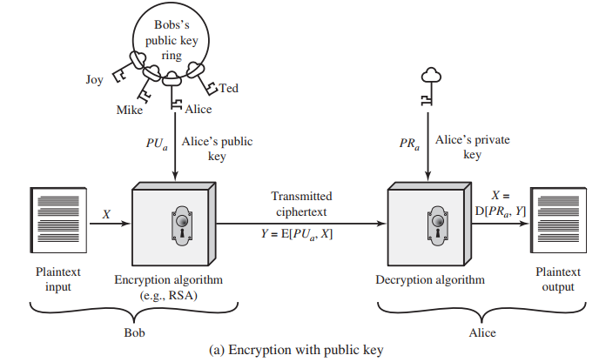

Slide 8
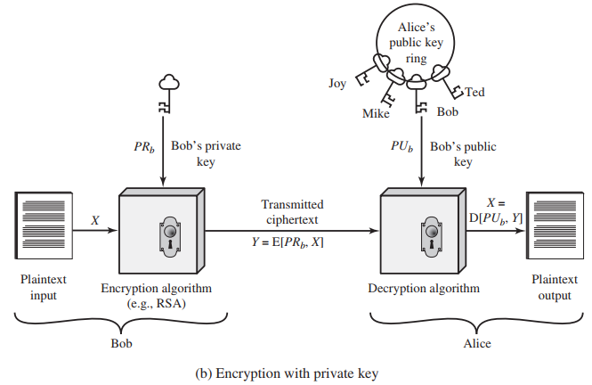

Slide 9
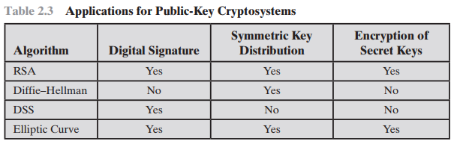

Slide 10
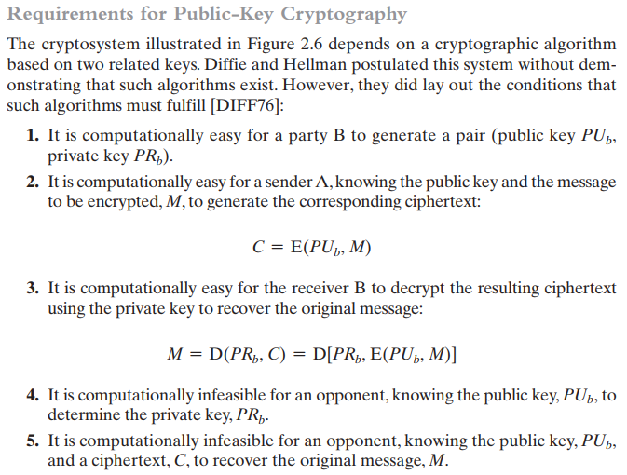
Requirement for Public Key Cryptography
Self Reading

Slide 11
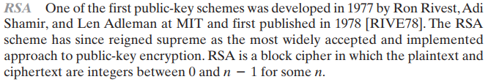


Slide 12
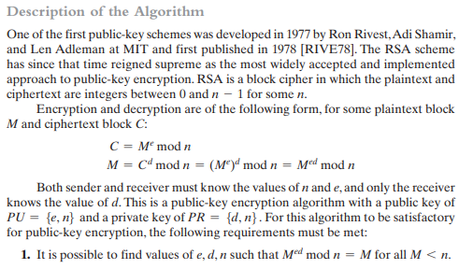
RSA Algorithm

Slide 13
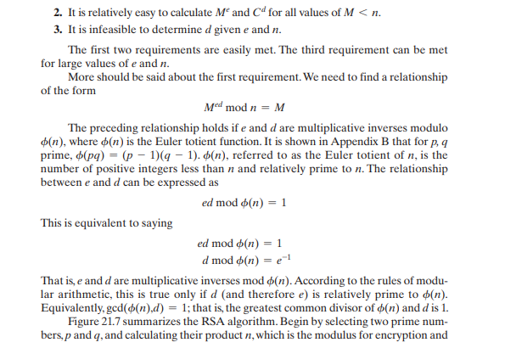
RSA Algorithm

Slide 14
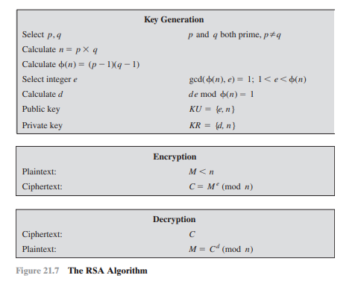
RSA Algorithm

Slide 15
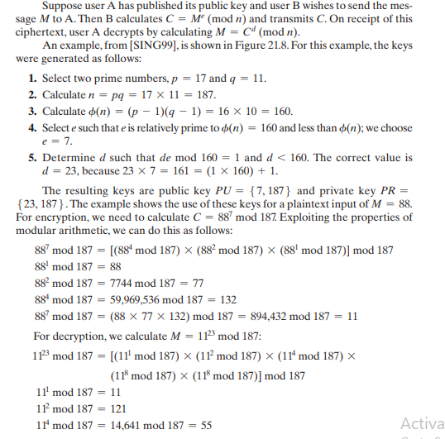
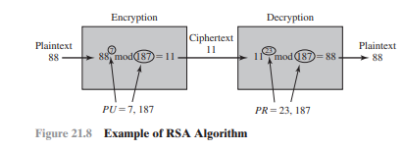
RSA Algorithm: Example

Slide 16
Digital Signature And Key Management
Public-key algorithms are used in a variety of applications.
In broad terms, these applications fall into two categories:
digital signatures, and various techniques to do with key management and distribution.
With respect to key management and distribution, there are at least three distinct aspects to the use of public-key encryption in this regard:
The secure distribution of public keys
The use of public-key encryption to distribute secret keys
The use of public-key encryption to create temporary keys for message encryption

Slide 17
Digital Signature
Public-key encryption can be used for authentication with a technique known as the digital signature.
NIST FIPS PUB 186-4 [Digital Signature Standard (DSS), July 2013] defines a digital signature as follows:
The result of a cryptographic transformation of data that, when properly implemented, provides a mechanism for verifying:
origin authentication
data integrity and
signatory non-repudiation.
Thus, a digital signature is a data-dependent bit pattern, generated by an agent as a function of a file, message, or other form of data block. Another agent can access the data block and its associated signature and verify:
data block has been signed by the alleged signer,
the data block has not been altered since the signing.
the signer cannot repudiate the signature.

Slide 18
Digital Signature
FIPS 186-4 specifies the use of one of three digital signature algorithms:
Digital Signature Algorithm (DSA): The original NIST-approved algorithm, which is based on the difficulty of computing discrete logarithms.
RSA Digital Signature Algorithm: Based on the RSA public-key algorithm.
Elliptic Curve Digital Signature Algorithm (ECDSA): Based on elliptic-curve cryptography.

Slide 19
Digital Signature
Steps
Bob wants to send a message to Alice. He wants Alice to be certain that the message is indeed from him. For this purpose:
Bob uses a secure hash function, such as SHA-512, to generate a hash value for the message.
That hash value, together with Bob’s private key, serve as input to a digital signature generation algorithm that produces a short block that functions as a digital signature.
sends the message with the signature attached.
When Alice receives the message plus signature, she:
calculates a hash value for the message;
provides the hash value and Bob’s public key as inputs to a digital signature verification algorithm. If the algorithm returns the result that the signature is valid, Alice is assured that the message must have been signed by Bob.
No one else has Bob’s private key, and therefore no one else could have created a signature that could be verified for this message with Bob’s public key.
In addition, it is impossible to alter the message without access to Bob’s private key, so the message is authenticated both in terms of source and in terms of data integrity.
The digital signature does not provide confidentiality.
That is, the message being sent is safe from alteration, but not safe from eavesdropping.

Slide 20
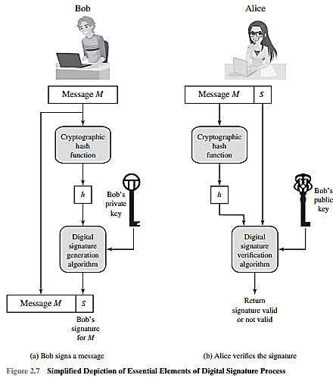

Slide 21
Although this approach is convenient, it has a major weakness. Anyone can forge such a public announcement. That is, some user could pretend to be Bob and send a public key to another participant or broadcast such a public key. Until such time as Bob discovers the forgery and alerts other participants, the forger is able to read all encrypted messages intended for Bob and can use the forged keys for authentication.

Slide 22
